Slide 1






V
HackOrbit 2025
HackStreet Boys

Slide 2

THEME & PROBLEM STATEMENT
Problem Statement Title – Smart Expense Management System (for College Students)
Theme - Financial Empowerment for Students
PS Category – Software
Domain – Fintech Innovation

Slide 3
PROPOSED SOLUTION
Smart Expense Mate is an all-in-one Web app that:
📊 Tracks daily spending with smart categorization.
🤖 Uses AI to provide personalized budgeting insights.
🤝 Enables seamless group expense sharing (e.g., for trips or shared accommodation).
🎓 Offers educational content to improve financial literacy and warn against financial pitfalls.

Slide 4
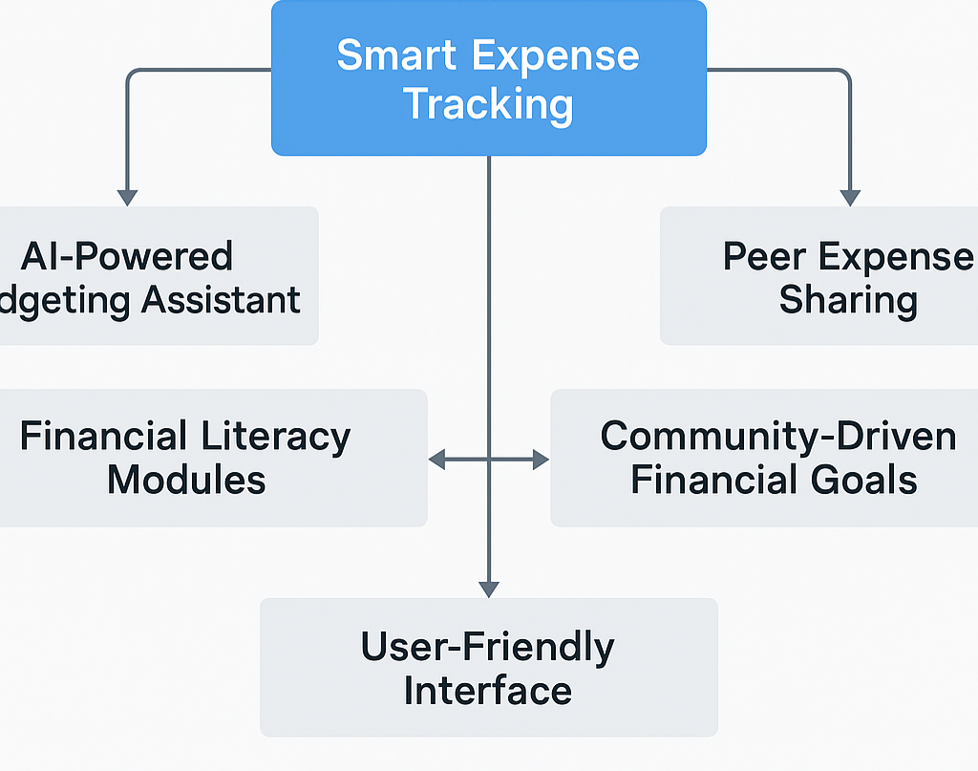
FLOWCHART / DIAGRAM

Slide 5
Explainer text
Smart Expense Tracking: Core feature to log and categorize spending.
AI Budgeting Assistant: Gives personalized saving tips.
Peer Expense Sharing: Simplifies group bill splitting.
Financial Literacy Modules: Educates on money habits and risks.
Community Goals: Enables shared financial goals.
User-Friendly Design: Simple and student-focused interface.

Slide 6
FEATURES AND NOVELTY
FEATURES
NOVELTY
Expense Tracking: Easy logging and categorization of spending. AI Budgeting: Smart, personalized financial suggestions. Peer Sharing: Simple group expense management. Financial Literacy: Quick lessons and risk alerts. Goal Setting: Track goals with peers.
Student-Centric Design
Combines tracking with financial education
AI-powered personalized budgeting
Promotes peer collaboration on goals
Raises awareness on financial risks like gambling
Focuses on social impact

Slide 7
DRAWBACK AND SHOWSTOPPERS
⚠️ Drawbacks Limited Financial Data: Students may not input all expenses, affecting accuracy. AI Accuracy: Budget suggestions depend heavily on consistent user input. Privacy Concerns: Handling financial and group data requires strong security. Internet Dependency: Most features may require online access.
🛑 Showstoppers
Data Privacy Breach: Any mishandling of user financial data can break trust.
AI Malfunction: Poor predictions or irrelevant suggestions can ruin user experience.
Group Conflict: Mismanaged peer expense sharing may lead to disputes.
Scalability Issues: Failure to handle a growing user base could limit impact.

Slide 8
TEAM NAME - HackStreet Boys
Team Members
Contact Details
Anshuman Singh Thakur
Aashay Sangam
Anuj Kumar
Anish Malaiya
7470890125
7415476796
9631864092
8120272815

Slide 9
Thank you

